Slide 1
IVY PROFESSIONAL SCHOOL ML INTERNSHIP ON FAKE NEWS DETECTION
Submitted To:- Submitted from:-
Eeshani Sood Agrawal Arun Deepak Tirkey
And Student ID :- 3644
Mohammad Rakib Branch :- Delhi

Slide 2
Problem Statement
What is fake news ?
Answer - Fake news, also known as junk news or pseudo-news, is a type of yellow journalism or propaganda that consists of deliberate disinformation or hoaxes spread via traditional news media (print and broadcast) or online social media.
Incident - Misinformation related to coronavirus COVID-19 pandemic is in the form of social media messages related to home remedies that have not been verified, fake advisories and conspiracy theories.
Problem statement of this project is :-
If we get any news, how do we determine whether it is fake or real ?
To classify target variable, real news data are given Label = 1 and fake news data are given Label = 0.
To get insights in Text data, Word Cloud are used after cleaning, correcting and filtering word data.

Slide 3
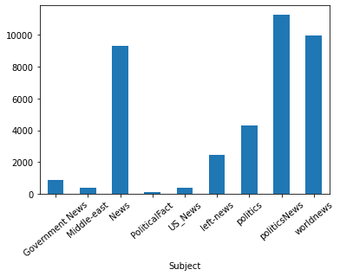
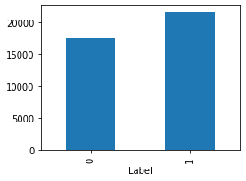
Dataset and Processes
Initially dataset consist of 45452 rows and 4 columns where Title, News_text, Subject and Label are columns.
Label variable is introduced to specify which rows are fake and real.
After consolidate both real and fake data, they are cleaned and this process having removing useless words in a sentence, correcting incorrect words and stemming and lemmatization of words.
Finally, data are numerically structured in 0 and 1 form for modelling and this consists of 39085 rows and 10010 columns.

Slide 4
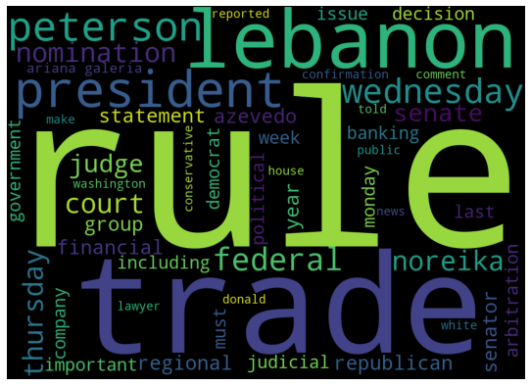
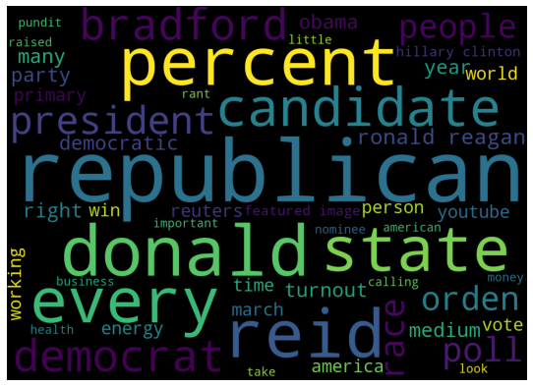
Words in News_text
Real Data
Major frequent words are :-
Rule, trade, Lebanon, federal, nomination, president, court, Wednesday, judge, judicial
This tells more news about election and constitution of USA .
Fake Data
Major frequent words are:-
Republican, state, Donald trump, candidate, democrat, poll, America, vote
This tells major dataset consist of both party of America in their polls campaign.
REAL DATA
FAKE DATA

Slide 5
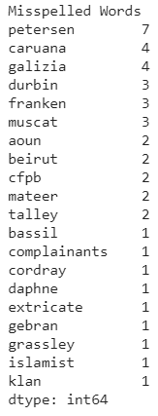
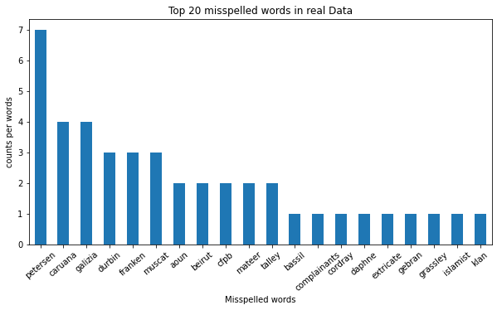
Mis-Spelled Words in Real Data

Slide 6
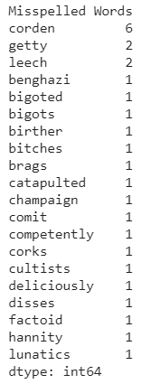
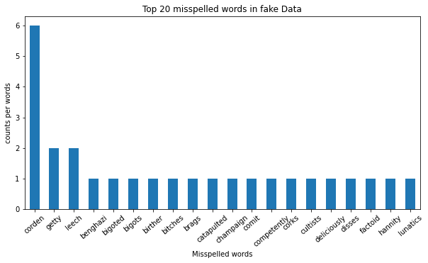
Mis-Spelled Words in Fake Data

Slide 7
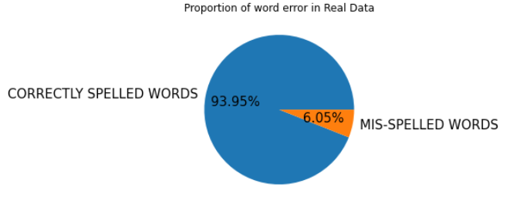
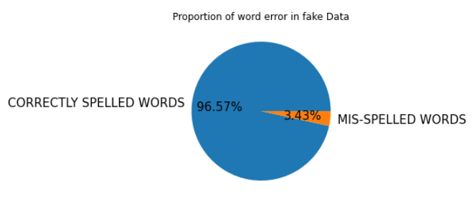
Text Cleaning

Slide 8
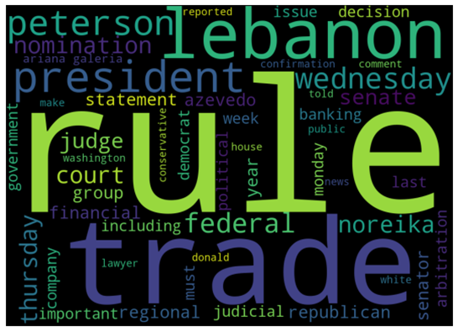
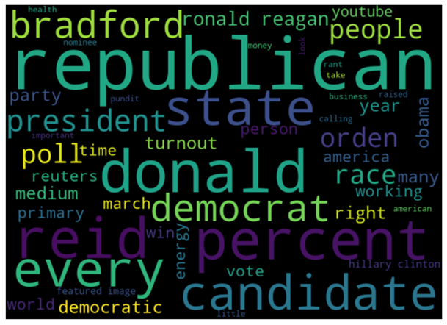
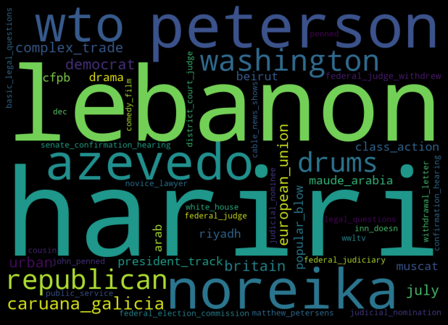
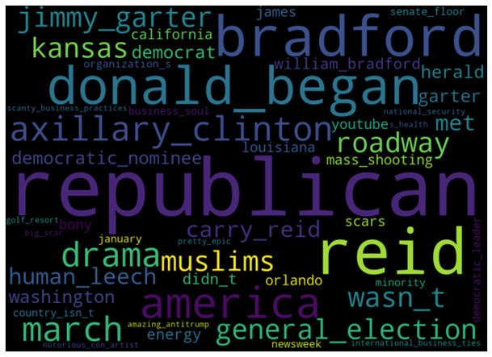
Plots on WordClouds | Fake Data
Unigram WordCloud (Real Data) | Unigram WordCloud (Fake Data)
Bigram and Trigram WordCloud (Real Data) | Bigram and Trigram WordCloud (Fake Data)

Slide 9
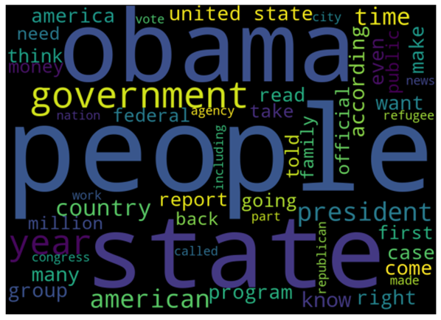
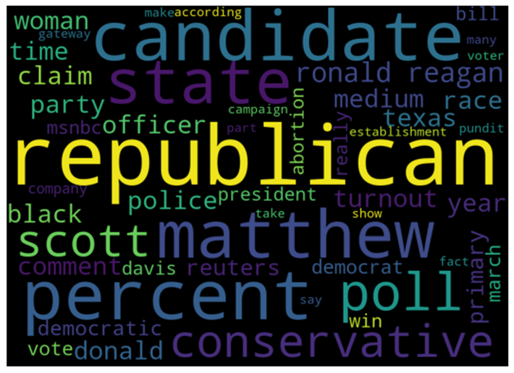
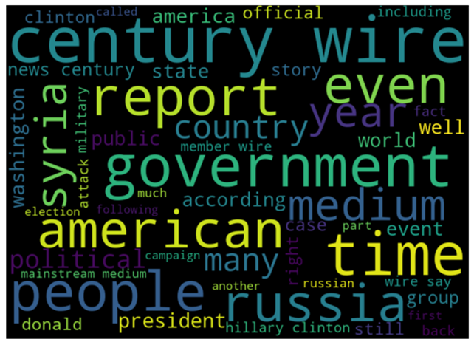
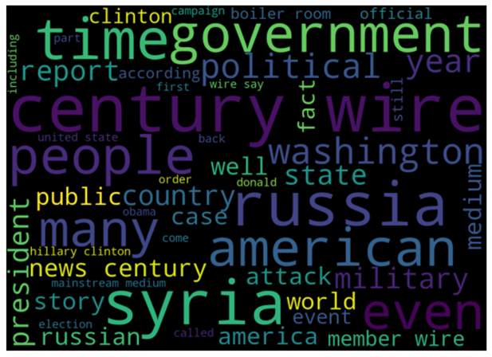
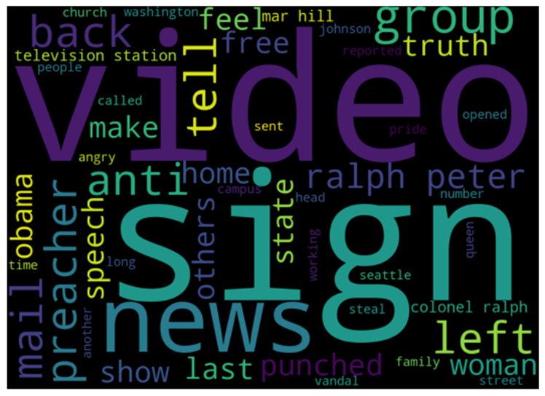
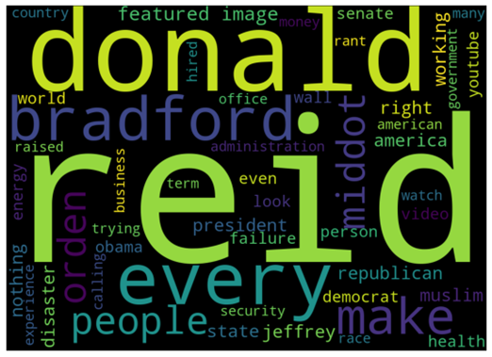
Wordclouds of fake news in each subject
Government News | Left News | US News
Middle East | Politics | News

Slide 10
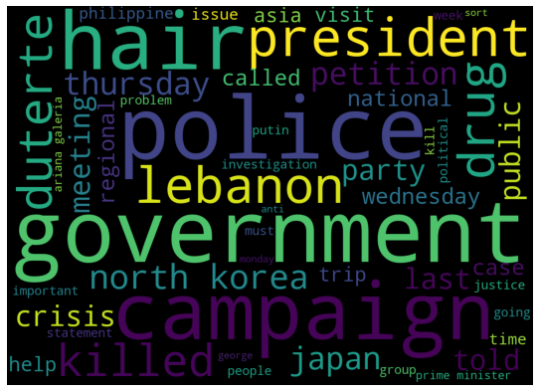
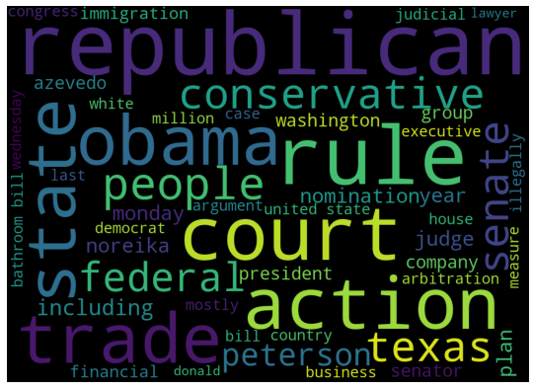
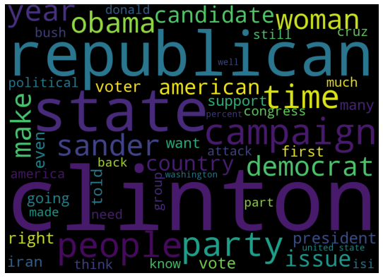
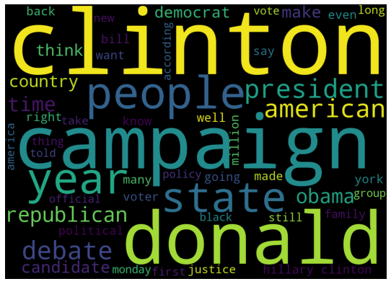
Page 8 – Wordclouds of real news in each subject.
Wordclouds of real news in each subject
World News | Political News
Political Fact | News

Slide 11
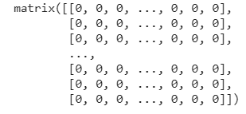
Numerical Format
Filtered text are then converted to numerical format using Python library called sklearn. In this library CountVectorizer method is placed in feature_extraction.text file. CountVectorizer method is used to form matrix of text in 0 and 1 form.
Figure :-

Slide 12
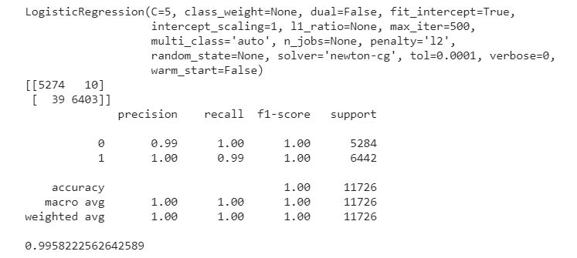
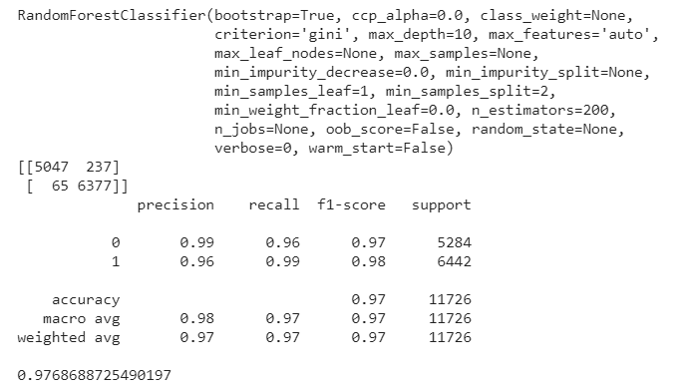
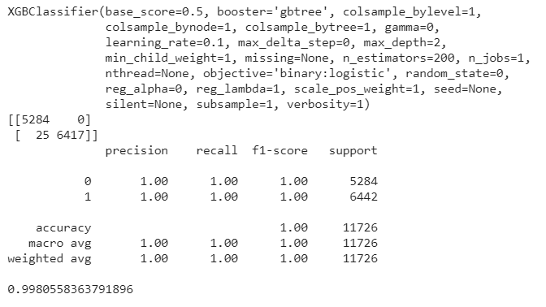
Machine Learning Models
Parameters, Confusion Matrix, Classification Report and F1 score :-

Slide 13
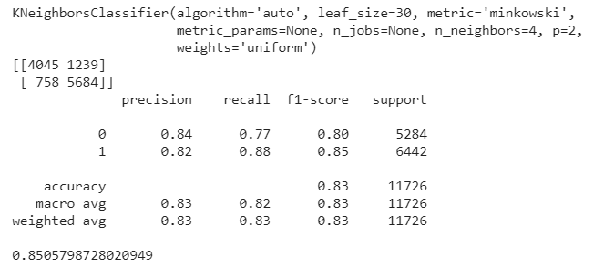
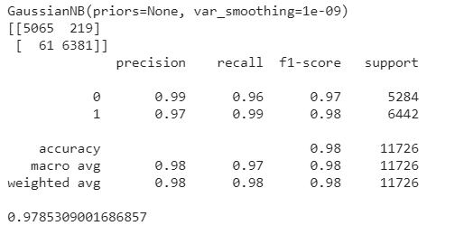
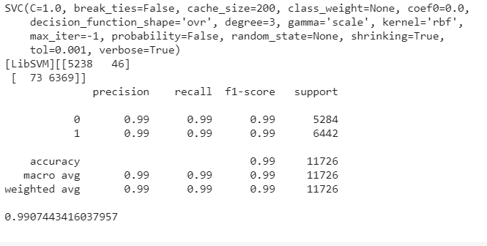
Machine Learning Models
Parameters, Confusion Matrix, Classification Report and F1 score :-

Slide 14
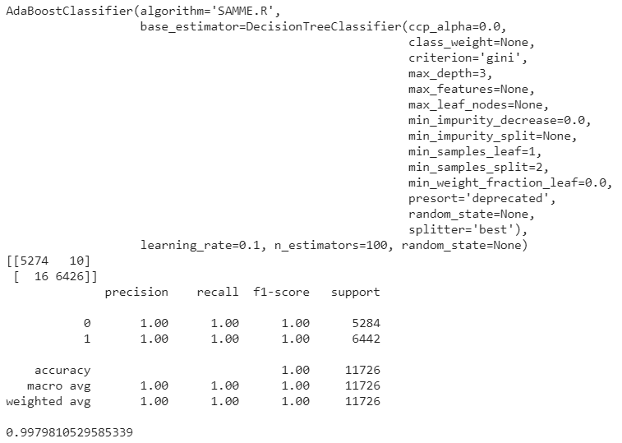
Final Model Selection
Among them I choose AdaBoost model as final model because of its less False Positive and Negative value. In terms of accuracy all are in range of above 95%.
Parameters, Confusion Matrix, Classification Report and F1 score:-

Slide 15
Difficulty came across and Suggestion
Difficulty I face while in this project was :-
Firstly, when I was correcting words in for loop, that time I didn’t knew about tqdm library of python and cant find out how much process was done.
Secondly, no stemming library was working correctly and after finding a lot in internet. I got across krovetzstemmer and this was working as expected.
This is very time consuming project. Correcting words in news_text takes 9 hrs in Google Colab Pro as this having 30k rows and each record have long news details. Model fitting of each algorithms takes average of 2 hrs approx.

